Slide 1
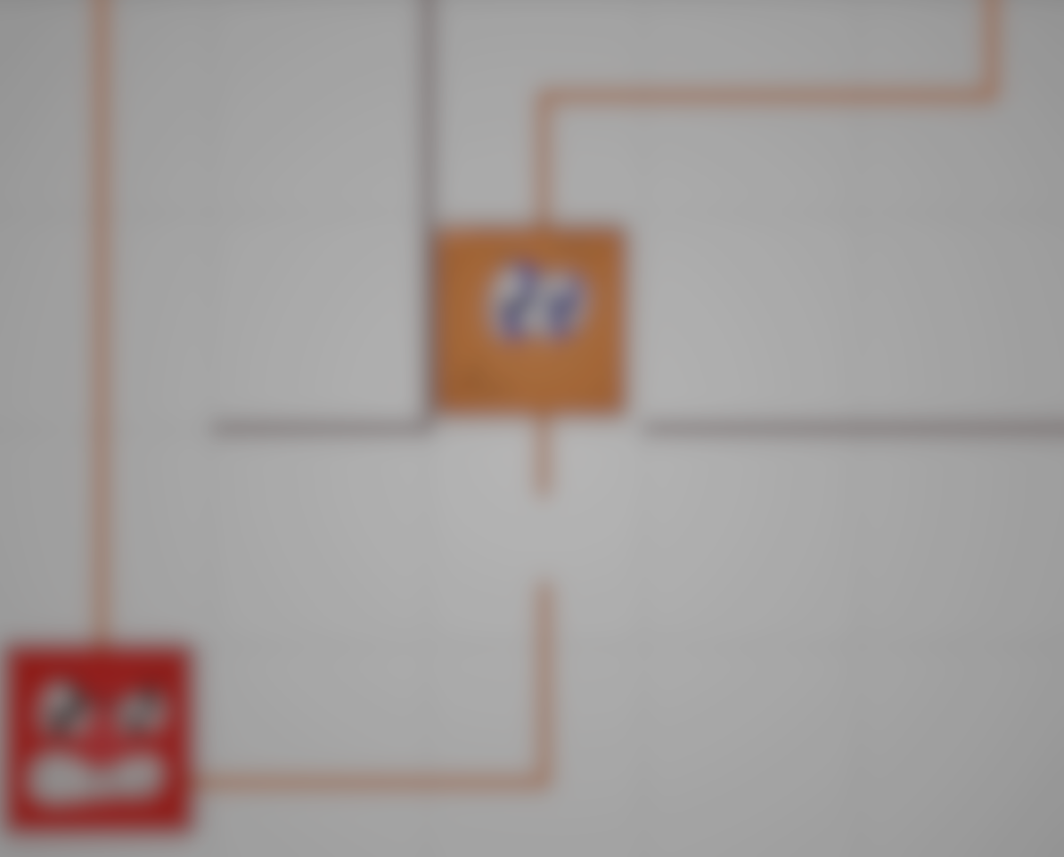

Control the electro conducting cubes in order to complete the circuit on each level.
Maxx Achtman, Hristo Bonev

Slide 2
Backstory
The year was 1879. Thomas Edison discovered a way to use electricity to light up buildings instead of using candles. His first invention used a platinum filament. However, in the summer of 1880 Edison decided to use carbonized bamboo for his filament. It was not until 1882 where he created his DC based power infrastructure, and this is where our story begins.
Word slowly began to spread around town of Thomas Edison and this fancy new way to control electric circuits to light the houses. As word spread however, not everyone was happy. The console of Amish have been in discussions about this new technology. They decided to kidnap Thomas Edison and prevent his knowledge from coming out to more people than it has already reached.
One night, Thomas Edison was figuring out a way to allow electric currents to communicate to one another on higher lengths. It was on this night, three people of the Amish council broke into his house, drugged him, and carried his passed-out body to their home.

Slide 3
Story of our Game
The next day, one of Edison’s friends came knocking on his door, but there was no response. This continued for the following week until his friend chose to kick his door down and realized Edison was gone. All Edison left behind were a couple of cubes and a note. The note read “To whoever may find my latest creation, these are the answer to my final work. You must take these cubes and place them on my circuits. Help guide them to the right places for my electric currents to work.”
So, his friend takes the cubes in hand and with the help from the player, we can save Thomas Edison from the Amish!

Slide 4
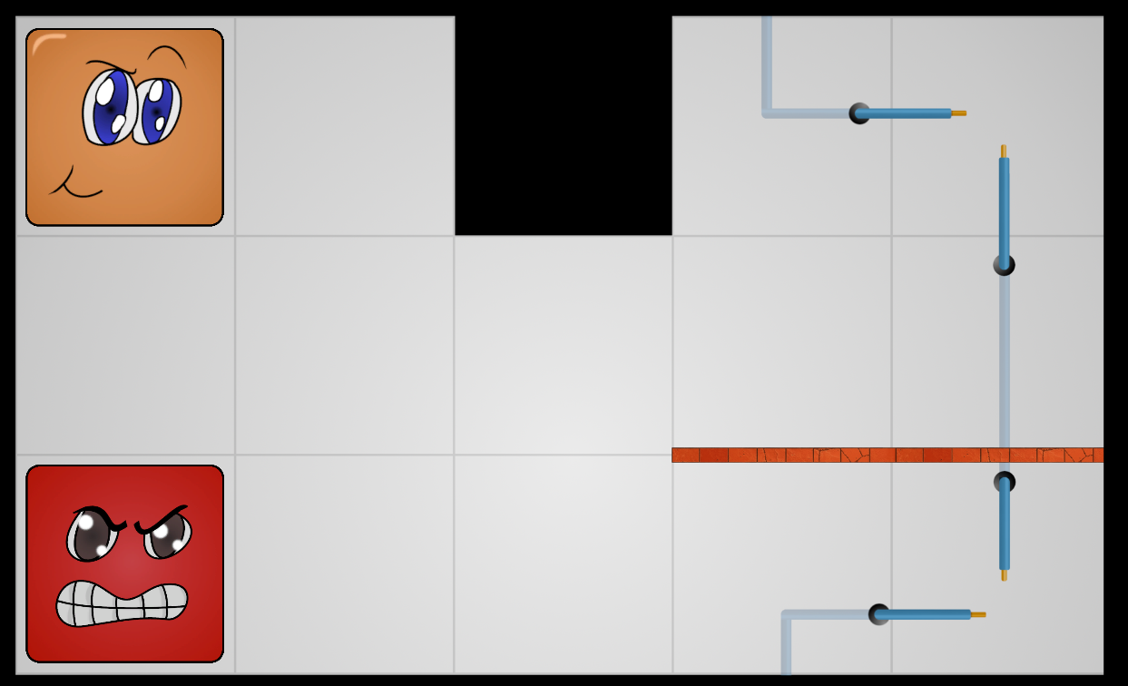
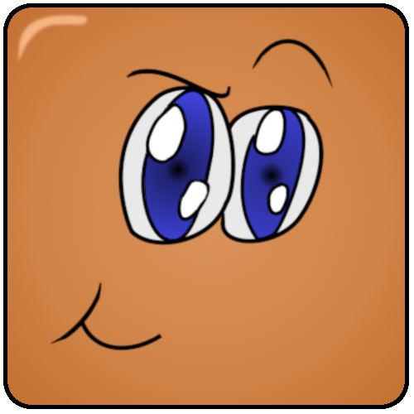



Appearance and Feel
Our game is a top down perspective where all cubes are placed in predetermined locations. In order to beat the level, the cubes have to complete the circuit.
The game was not designed to frustrate its players, but rather make them think in a critical manner while keeping a playful attitude.
Cuby
Squaresome
Rectahelper
Nervangle

Slide 5
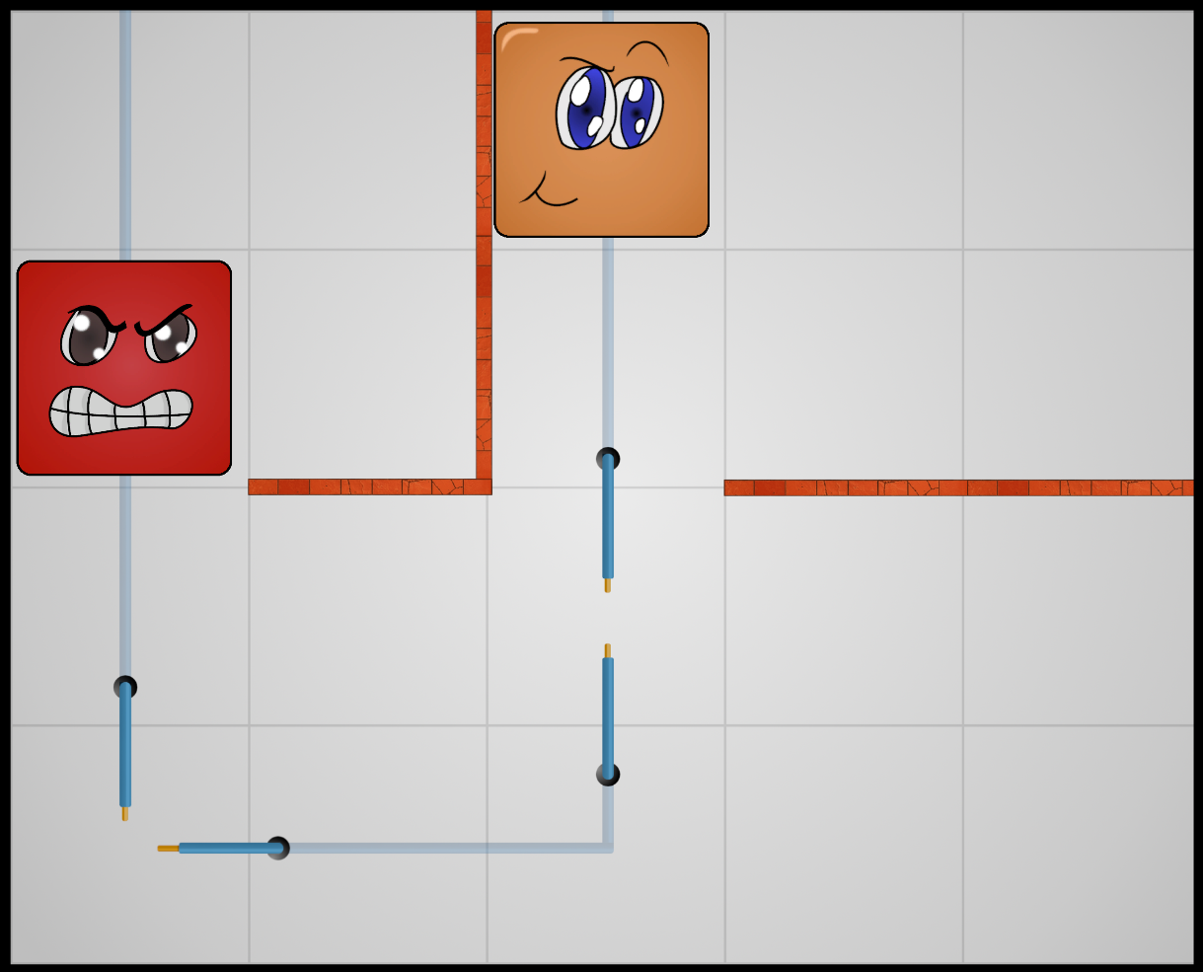
Board Layout
Our board has a black border to signify our boundaries
Red Brick walls through which the cubes cannot pass. The conducting cubes must be placed on the blue wires with prongs on either end. This will complete the circuit.

Slide 6
Player Roles and Actions
The player has to find the correct path in order to complete the circuit on each level. To do that, the player will have to use the inner walls to prevent a cube(s) from moving, while adjusting the other cube(s). The player is able to restart a level if he/she is having trouble finding the correct way to complete the circuit.

Slide 7
Strategies & Motivations
One strategy for this game is to draw out the level as it is shown to the user. This would allow the player to figure out what steps would be needed to solve the puzzle before even starting it. While the user is not timed to complete the level within a certain time frame, it may impact the user’s enjoyment of the game. Another strategy is to use trial-and-error. The user has the ability to restart a given level as many times as he wishes. Given enough time, the user should be able to find the path for completing the circuits.
Players have the option of
The player’s main motivation is saving Edison from the Amish. This goal can be achieved by using the electro conducting cubes that were left behind by Edison. The only question is, will the player be able to guide the cubes to complete all of Edison’s complicated circuits?

Slide 8
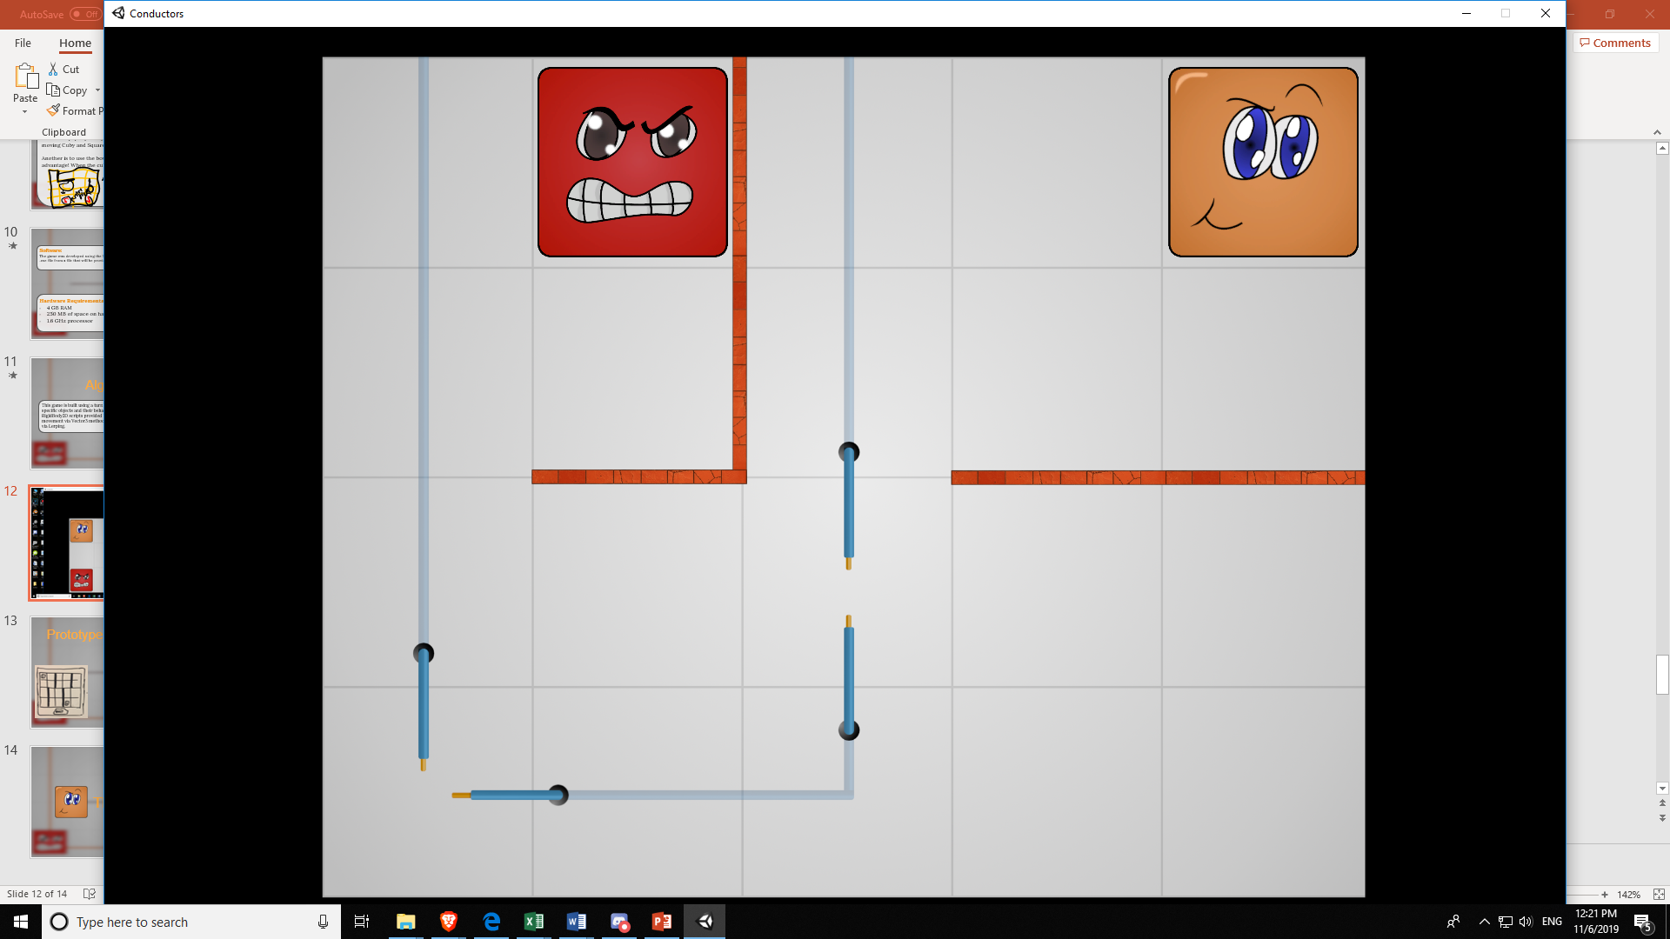
Level Summary:
Our game starts off with an introduction to our actual story. The player learns about Edison being taken by the Amish and the origins of the cubes. The first level was designed to help the player learn the basics of our game mechanics. By beating this level, the player would have learned how to use walls to his advantage in order to move one cube, while the other stays put. The second level is a bit harder, but given enough time the player should be able to figure out how to complete the circuit.
Level 1
Level 2

Slide 9
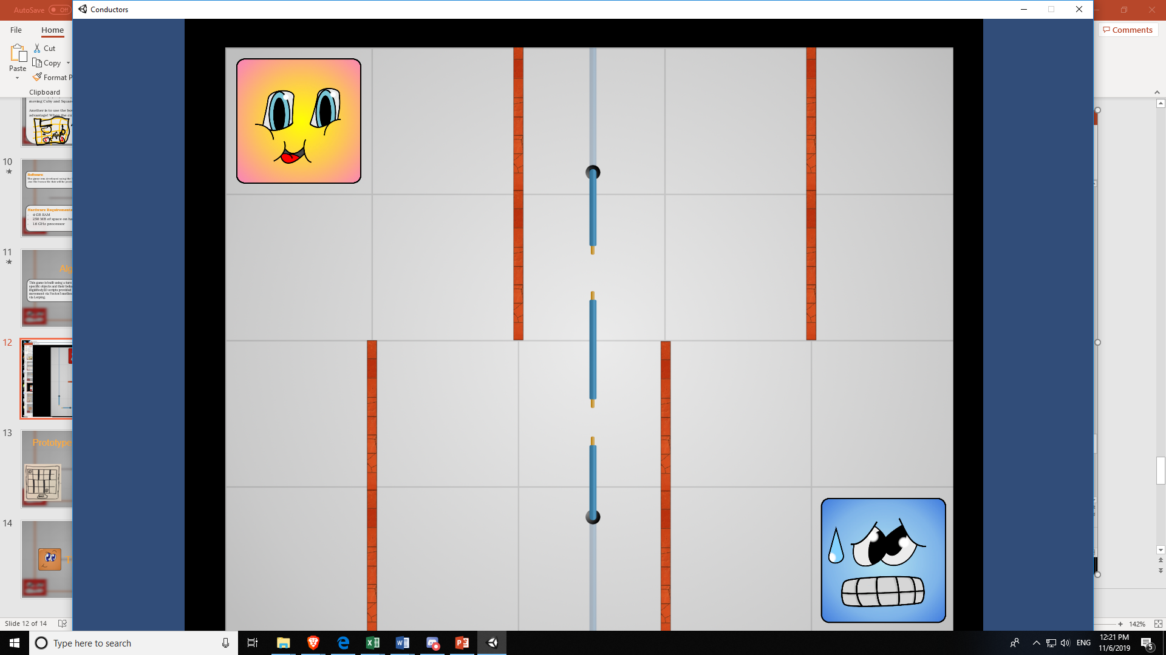
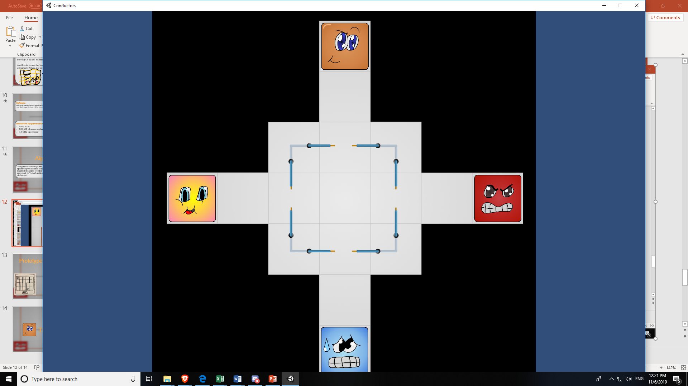
Level Summary: (continued)
Upon entering level 3 you are introduced with two new characters Nervangle and Rectahelper. This level will really test your puzzle solving skills. Upon completing level three, the player will be presented with level 4. To beat this level, the player will have to simultaneously control not 2, but 4 cubes! If you can beat this level, then congratulations! You would have beaten our game and saved Edison from the Amish!
Level 3
Level 4

Slide 10
Are there hints on how to play?
One suggestion is to draw out our board the way you see it and conduct a paper prototype of it. Figure out the puzzle before even moving Cuby and Squaresome!
If the player is having a lot of trouble with a level, he/she can open the “HowToBeatEachLevel.txt” file. The file contains information on what arrow keys need to be pressed in order to beat each level.

Slide 11
Software:
The game was developed using the Unity Game engine. This program can be executed via a .exe file from a file that will be provided to the player upon downloading our game.
Hardware Requirements:
4 GB RAM
250 MB of space on hard drive
1.6 GHz processor

Slide 12
Algorithm Style
This game is built using a turn by turn based algorithm style. We are using a 2D array that is built from Tile objects. The Tile class holds a list of available movements. With each movement, we upgrade where each one of our characters is currently located in the array. The algorithm would also test if a specific tile is an open circuit. For example, a given tile could have Cuby on a specific tile with it also being an open circuit tile (the location where the cubes need to be to complete the level) and if it is, then the circuit is complete for Cuby. This could be further added by saying if Cuby and Squaresome are both occupying an open circuit tile, then the level has been completed successfully.

Slide 13
Algorithm Style (continued)
The algorithm is also responsible for character movement. For example, if one of the cubes wanted to move to the right, it would look at the tile it’s currently on and see if the “right movement” is available or not. If it is available (i.e. no walls have been placed there) then Cuby can move to the right.
One final example of our algorithm is controlling how Cuby and Squaresome would handle moving in the same direction where one is in the next position of the other. Say Cuby and Squaresome are on two tiles next to each other. Cuby wants to move right, but the tile is currently occupied by Squaresome. Our algorithm would test Squaresome’s movement first. If Squaresome can move to the right, so can Cuby. However, if Squaresome cannot move to the right, Cuby won’t be able to execute his movement as well.

Slide 14
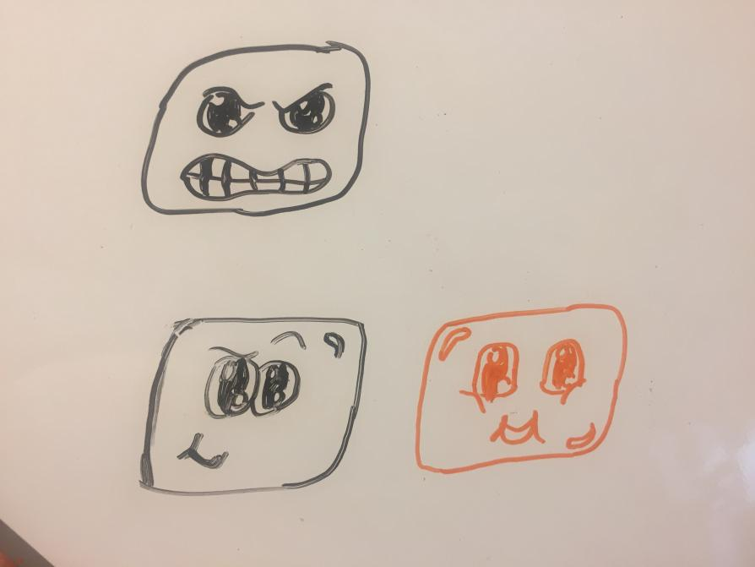
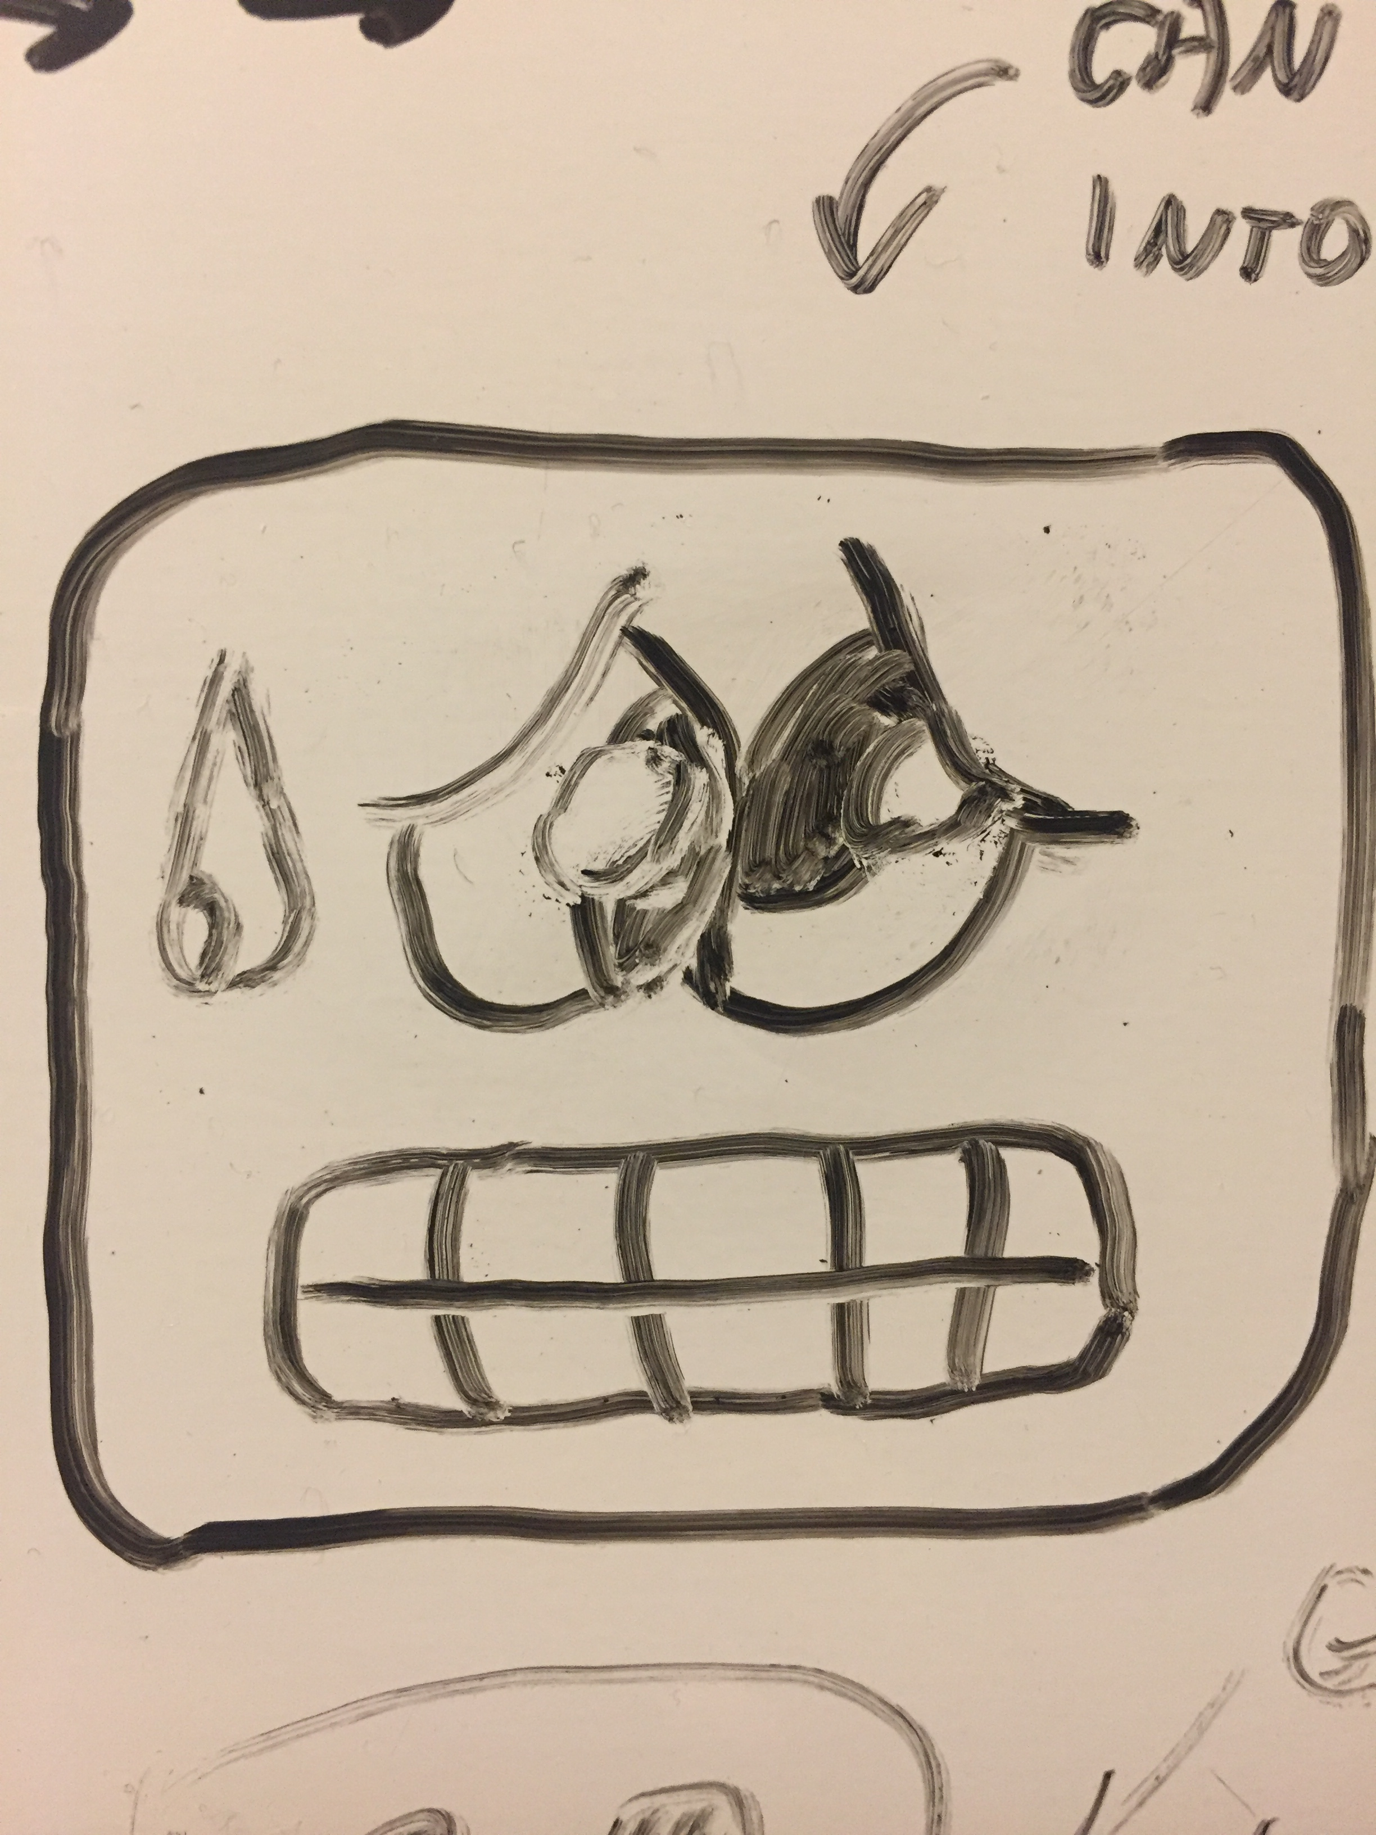
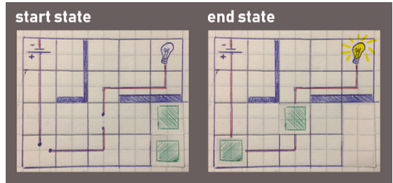
Paper Prototypes:
Level 2

Slide 15
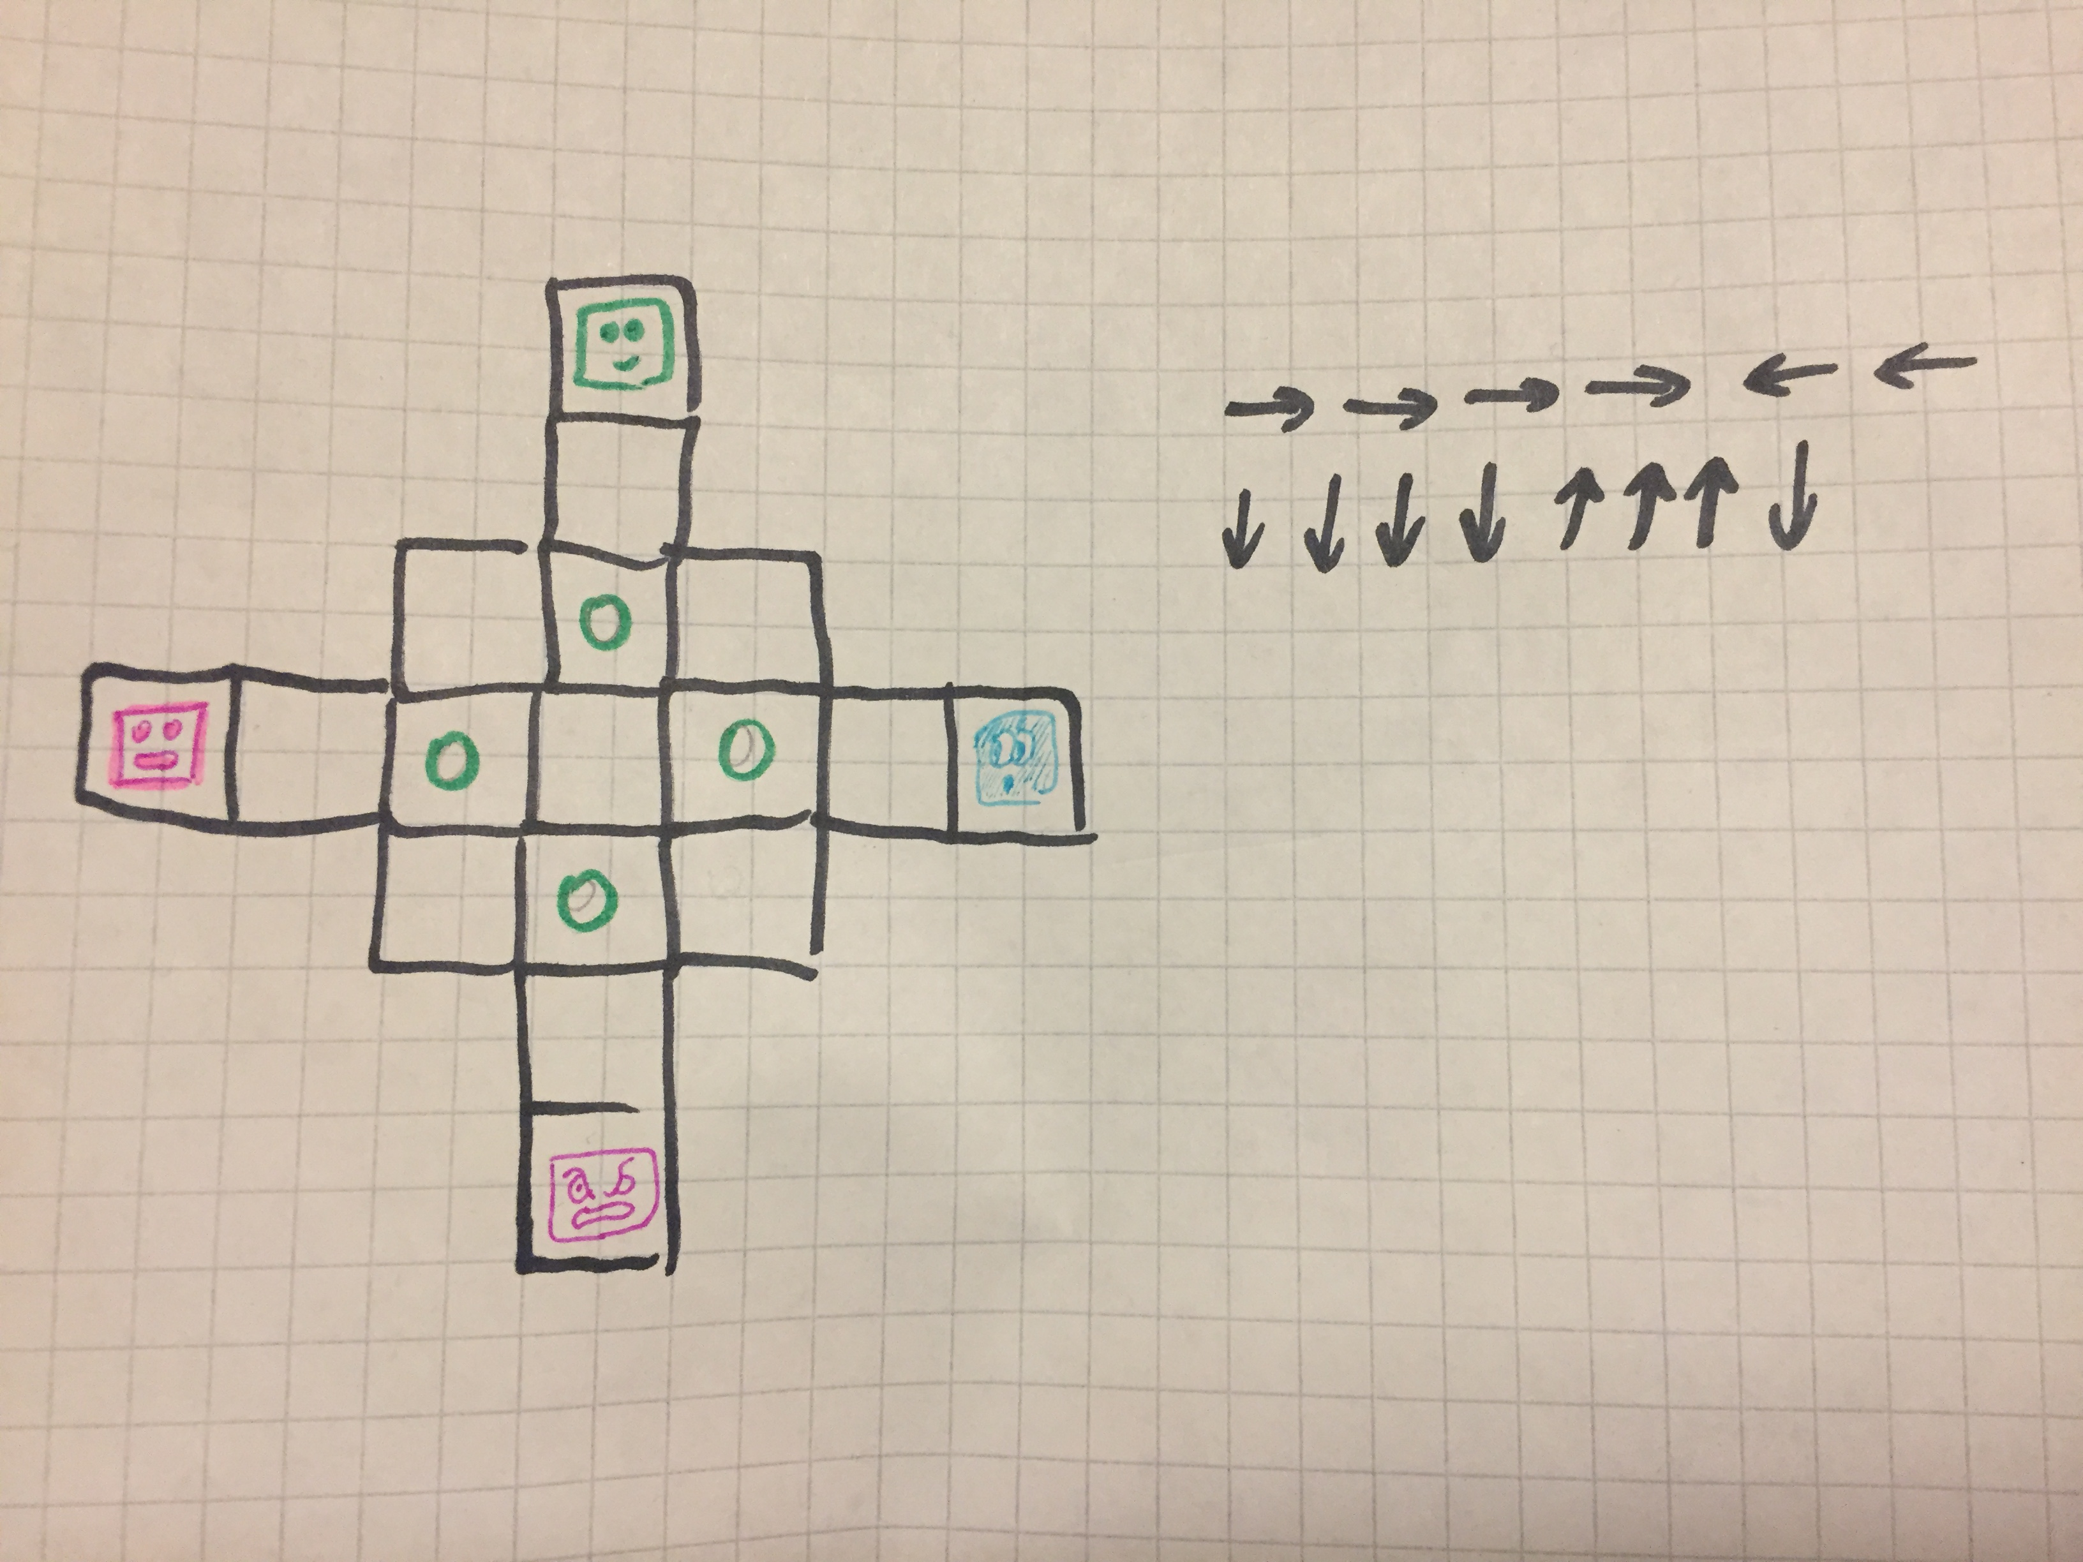
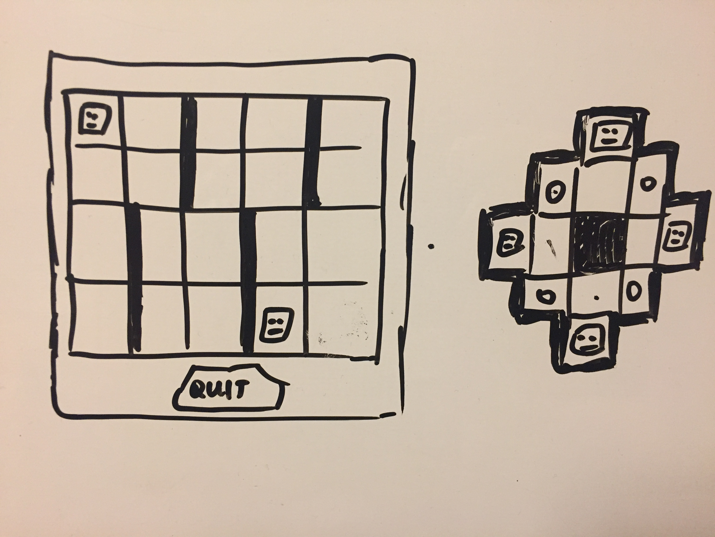
Prototypes of levels 3 and 4:
Level 3
Level 4

Slide 16
Thank you!

